Slide 1
Teach reading: change lives
Parent workshop: Phonics and early reading in Reception, Phase 2
(Autumn 1)
Notes:
For this presentation, you will need to download and print out the following resources and information for parents:
Phase 2 grapheme information sheet – Autumn 1
the parent handout ‘Your child’s reading journey – Reception Autumn term’
the Phase 2 and 3 grapheme mat
the Little Wandle Progression overview
‘Phase 2 tricky words: Reception Autumn term – Information for parents and carers’ – or parents can access this in the ‘For parents’ area of the Little Wandle website.
You will need a flipchart and access to the Little Wandle and Collins websites.
You may also wish to have a copy of the Little Wandle Glossary to hand (in Getting started/Teaching).

Slide 2
Phonics is:
making connections between the sounds of our spoken words and the letters that are used to write them down.
Notes:
Slide purpose:
To provide a simple definition of phonics
Suggested script:
So what is phonics?
Read the slide.
It sounds complicated but it really isn’t!
Let's learn some important words that will help you understand phonics ...

Slide 3
Terminology
Phoneme
Blend
Grapheme
Segment
Digraph
Trigraph
Notes:
Slide purpose:
To give simple definitions of key terminology
Notes:
Explain what each word means – use the Glossary to help.

Slide 4


We teach Phase 2 in this order
Notes:
Slide purpose:
To provide an overview of the Phase 2 sounds
Suggested script:
We usually teach four new sounds a week and have a review lesson on a Friday.
You will get a list of the sounds that we are learning to have at home. This will help you with letter formation (handwriting) and pronunciation.
Give the Phase 2 grapheme information sheet for Autumn 1 to parents.

Slide 5
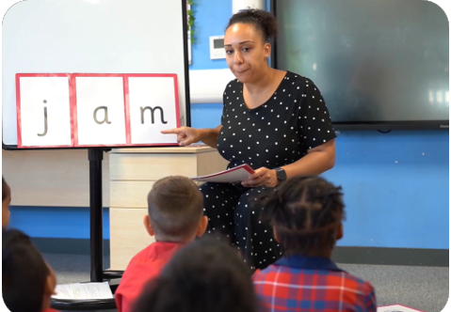
We teach blending so your child learns to read
Teacher-led blending is taught throughout phonics.
Children need lots of practice at blending sounds together to read words.
Your child will need to be able to blend confidently before moving onto a book with words.
Notes:
Slide purpose:
To introduce blending
Suggested script:
Teacher-led blending is teaching children how to blend, directed and demonstrated by the teacher.
It is repeated daily in the Autumn term.

Slide 6
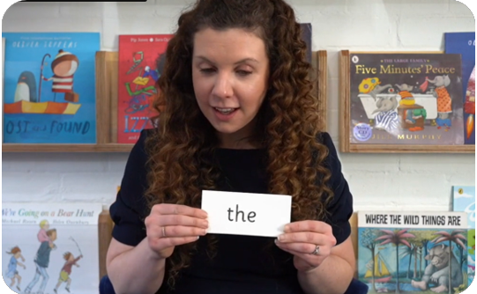
Tricky words
These words have unusual spellings e.g. he, the, was.
They are taught in a systematic way.
Children are now learning to read the Phase 2 tricky words: is, I, the, put, pull, full, as, and, has, his, her, go, no, to, into, she, push, he, of, we, me, be.
Notes:
Slide purpose:
To introduce tricky words
Notes:
Read the slide.
You may wish to give parents a copy of the document ‘Phase 2 tricky words: Reception Autumn term – Information for parents and carers'.

Slide 7
How do we practise reading in books?
Reading practice sessions are:
timetabled three times a week
taught by a trained teacher/teaching assistant
taught in small groups
At the end the week, we send home the book that has been practised in school.
Notes:
Slide purpose:
To introduce decodable books
Suggested script:
The children read the same book three times in a week.
The first time we work on decoding (sounding out) the words, the second time we work on prosody which is reading with expression – making the book sound more interesting with our story-teller voice or our David Attenborough voice – and the third time we look at comprehension.
We read the books three times at school because we want to develop the fluency.
The more children see words, the more they begin to read them automatically without having to sound them out.

Slide 8

Books going home
Notes:
Slide purpose:
To introduce the process and format for reading at home
Suggested script:
As well as the ‘learning to read’ book that your child will bring home they will also bring home a book for sharing with you.
This shared book is SO important. This is how we are going to give them the WILL to read.
Please read with your child as often as you can – at least once a day if possible.

Slide 9
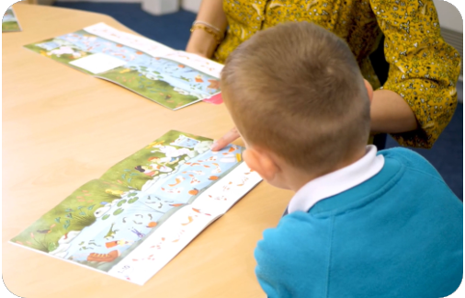
Reading a wordless books
Wordless books are invaluable as they teach reading behaviours and early reading skills to children who are not blending – yet!
Talk about the pictures.
Point to the images in the circles and find them on the page.
Encourage your child to make links from the book to their experiences.
Notes:
Slide purpose:
To give guidance on reading wordless books at home
Notes:
Read the slide.

Slide 10
Listening to your child read their phonics book
Your child should be able to read their book without your help.
They might sound out words and blend them before they read them fluently.
If they can’t read a word, read it to them.
Talk about the book and celebrate their success.
Notes:
Slide purpose:
To give guidance on reading the decodable book at home
Notes
Read the slide.

Slide 11

Read to your child
The shared book is for YOU to read:
Make the story sound as exciting as you can by changing your voice.
Talk with your child as much as you can:
  Introduce new and exciting language.
  Encourage your child to use new vocabulary.
  Make up sentences together.
  Find different words to use.
  Describe things you see.
Notes:
Slide purpose:
To give guidance on reading the shared book at home
Notes:
Read the slide.

